Slide 1
Overview:
Whole School, Whole Community,
Whole Child (WSCC)
Trainer Name
Date
Notes:
WELCOME
STATE: Good morning. My name is _________ and welcome to the Whole School, Whole Community, Whole Child Overview. The Whole School, Whole Community, Whole Child model is frequently abbreviated to WSCC — pronounced “wisk” — so you will see that abbreviation and hear me referring to the model as “wisk” throughout the training today.
NOTE: Participants may introduce themselves during this time if they don’t know each other and if time allows. Their introduction may include their name, position, and school/district/organization.

Slide 2
On Our Agenda . . .
Exploring the WSCC model
Assess your school’s implementation of the Healthy Tenet Indicators
Identify school resources and gaps for the WSCC 10 components
Identify next steps and additional training needs for adopting and implementing the WSCC model
Notes:
AGENDA
STATE: During this module, we’ll explore the essential elements of the Whole School, Whole Community, Whole Child model. We will assess your school’s current level of implementation of the Healthy Tenet and identify human resources and gaps for engaging a a WSCC team in an annual process to improve student health and education outcomes.
A WSCC team is a school or district-level committee whose members reflect the components of the WSCC model, and whose priorities include using the model to implement continuous improvement in addressing the needs of the whole child. We will talk more about the WSCC team later in the training.

Slide 3
Objectives
Describe the WSCC model (tenets, components, community)
Assess the school’s current state of addressing one of the tenets — the healthy tenet — and address the WSCC 10 components
Explain the importance of family and community engagement in school health
Notes:
OBJECTIVES
STATE: By the end of this session, you’ll be able to:
Describe the WSCC model (tenets, components, community)
Assess the school’s current state of addressing one of the tenets — the healthy tenet — and addressing the WSCC 10 components
Explain the importance of family and community engagement in school health

Slide 4
Materials
Handout Packet
#1: Key Points and Notes
#2: Healthy Tenet
#3: WSCC 10 Components
#4: Steps for Adopting and Implementing the WSCC Model
#5: Additional Resources
Notes:
MATERIALS
STATE: Let’s review the handouts you were given in the packet. You have several:
#1 Key Points and Notes
#2 Healthy Tenet
#3 WSCC 10 Components
#4 Steps for Adopting and Implementing the WSCC Model
#5 Additional Resources
We’ll be using these throughout the training.

Slide 5
Whole School, Whole Community, Whole Child Model
Notes:
WSCC OVERVIEW
STATE: Find Handout #1 Key Points and Notes. Feel free to take notes on this handout as we talk about the WSCC model.
ASK: What is a model?
DO: Allow 2–3 participants to share their ideas.
STATE: A model is something used as an example to follow or emulate. In this case, the WSCC model is a framework for improving the health and learning of the students in our nation’s schools. It calls for greater alignment and integration between education and health.
ASK: What does the model say to you?
DO: Allow 2–3 participants to share their ideas.
STATE: Thank you for sharing. Let’s break down the model and look at the pieces that make up the whole model.
NOTE: As you talk about the different parts of the model, point to them on the PPT slide.
STATE: In the center, you can see that the focus is on whom? Correct: the student. For students to be successful in school, their basic needs for learning must be met. Students must be healthy, safe, engaged, challenged, and supported—these needs are represented in green and are called the five tenets.
To ensure this, all sectors within the school must work together. In other words, a whole school approach must be taken. This is reflected by what we call the WSCC 10 components. Finally, the whole model is surrounded by the community and its support and influence.
The WSCC Model represents a collaborative approach to learning and health. It emphasizes school wide engagement as well as community support.
So where did the concept of the WSCC model come from? This model is the result of collaboration between two national leaders. The Whole Child approach from the Association of Supervision and Curriculum Development (ASCD) and the Coordinated School Health approach from the Centers for Disease Prevention and Control (CDC) have been integrated into the WSCC model to demonstrate the symbiotic relationship between health and learning.

Slide 6

WSCC’s Five Tenets
Desired characteristics for all students:
Healthy
Safe
Engaged
Supported
Challenged
Notes:
WSCC FIVE TENETS
STATE: So, let’s take a deeper dive into the model. As we stated earlier, youth are at the center of the WSCC model. This ensures that the model’s focus is on keeping youth healthy, safe, engaged, supported, and challenged—the tenets or principles that schools, teachers, health professionals, families, and communities value. In addition to youth being the focus of this work, we should also recognize them as full partners in this work. Students are the recipients of this model, so it is important to hear and learn from them what works or helps in improving their learning and health. More about this concept can be found in the Engaging Youth Training Module.
The five tenets shown in green on the model are:
Healthy — Each student enters school healthy and learns about and practices a healthy lifestyle.
Safe — Each student learns in an environment that is physically and emotionally safe for students and adults.
Engaged — Each student is actively engaged in their learning and is connected to the school and broader community.
Supported — Each student has access to personalized learning and is supported by qualified caring adults.
Challenged — Each student is challenged academically and prepared for success in college or further study and for employment.
Again, the five tenets are the desired outcomes for every student and are critical for supporting academic achievement and student health. The tenets are based on Maslow’s hierarchy of needs where we must first meet the physical needs (physical health, safety, and a sense of belonging) before we can meet the social and emotional needs. So with that thought, the tenets of being healthy and safe provide the foundation and must be addressed to allow students to achieve the other tenets of being engaged, supported and challenged.
Today, we are going to focus on the Healthy tenet.

Slide 7
Healthy Tenet
What does a school look like where students know and are able to practice a healthy lifestyle?
Notes:
HEALTHY TENET
STATE: Find Handout #2. Please read the healthy tenet goal and discuss with a partner the following question.
“What does a school look like where students know and are able to practice a healthy lifestyle?”
STATE: Jot down your thoughts on the handout.
DO: Give participants 2 minutes to discuss the two questions.
STATE: Let’s share some of your thoughts about what a healthy school looks like.
DO: Facilitate a short discussion.
STATE: Thanks for sharing.

Slide 8
Healthy Tenet Indicators
Read each indicator description
A listing of all tenet indicators can be found at: ascd.org/whole-child.aspx
Notes:
HEATHY TENET INDICATORS
STATE: Each of the five tenets has its own set of indicators. On Handout #2 you can see the list of indicators for the Healthy Tenet. Please take a few minutes to read the indicator descriptions.
A listing of all the tenet indicators can be found at www.ascd.org/whole-child.aspx.
Let’s continue our review of the WSCC model and now focus our attention to the ten components found in the teal colored area of the model. Many of these indicators link to the 10 components?

Slide 9
WSCC’s 10 Components
Health Education
Physical Education and Physical Activity
Counseling, Psychological, and Social Services
Health Services
Nutrition Environment and Services
Employee Wellness
Social and Emotional Climate
Physical Environment
Family Engagement
Community Involvement
Notes:
WSCC TEN COMPONENTS
STATE: The WSCC model highlights the ten components that every school should have to ensure the health, safety and well-being of students and staff. They are:
Health Education
Physical Education and Physical Activity
Counseling, Social Services, and Psychological Services
Health Services
Nutrition Environment and Services
Employee Wellness
Social and Emotional Climate
Physical Environment
Family Engagement
Community Involvement
STATE: So, think of the 10 components as the mechanism for achieving the WSCC tenets, especially the tenets — healthy and safe. The components represent the expert workforce that can unite the school and the school community in a process of continuous improvement. They are interconnected and all should be engaged in the work.

Slide 10
WSCC’s 10 Components:
An Organizational Framework
Academic Content Areas:
Health Education
Physical Education and Physical Activity
Services:
Counseling, Social Services & Psychological Services
Health Services
Nutrition Environment and Services
Employee Wellness
Environments:
Social and Emotional Climate
Physical Environment
Resourceful Partners:
Families
Communities
Notes:
STATE: On this slide, you can see how the components are connected with one another and how they work together to create a whole school approach to health and learning and the critical content students learn is supported and reinforced by the school’s services, environment and partners.
We can break down the components into:
Academic Content Areas: Health Education and Physical Education and Physical Activity;
Services: Counseling, Psychological and Social Services; Health Services; Nutrition Environment and Services, and Employee Wellness;
Environments: Social and Emotional Climate & Physical Environment
Resourceful Partners: Family Engagement & Community Involvement.
STATE: To improve coordination between health and learning, you will want to engage as many of the ten components as possible. This next activity will help you know who you need to engage in implementing the model and where there are gaps. If you identify any gaps, you will want to seek out people in your school or community to fill those gaps. Consider people who have expertise or passion for the component area.
Let’s look at Handout #3: WSCC 10 Components. The 10 components are listed along with the aligned healthy tenet indicator. Review both the component and indicator descriptions and consider how well you feel your school is addressing the component. Rank each from 1 to 4 with 1 being not implemented at all to 4 being fully implemented.
Next consider if there is someone at your school who is the lead or head of the component and write down the name of that person(s).
DO: Allow 13 minutes for the participants to complete.
STATE: You probably noticed that indicators 1, 7, 8 were not listed. That is because these three indicators cut across all ten components. Indicator 1 reminds us that the whole school needs to reinforce the health and well-being of every student. Indicator 7 reminds us that health and well-being needs to be included in professional development, curriculum development and assessment and finally indicator 8 reminds us that the school health goals affecting students and staff should be built on data and strong science. Take a few minutes and describe why these indicators are important for all ten components and how you could include or ensure each is integrated into the work of all the components.
DO: Allow 3 minutes for this work.
STATE: Hopefully this activity demonstrates the need for collaboration, integration, and cross-functional work when addressing health and learning. The School Health Index is a tool that helps demonstrate ways in which the components can work together. You can learn more about the School Health Index in the Assessing Training Module.

Slide 11
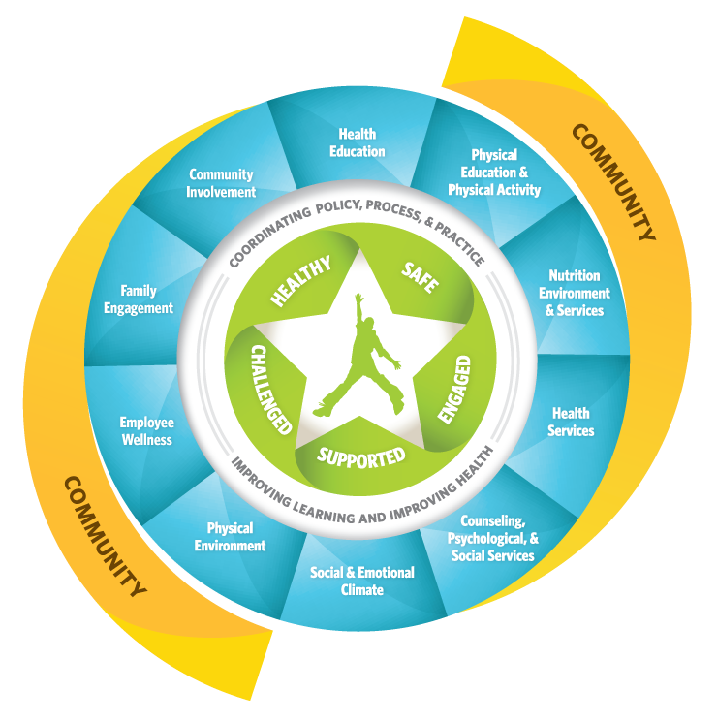
Coordinating Policy, Process, and Practice
Improving Learning and Improving Health
Notes:
STATE: Remember, the white portion of the model separating the tenets from the components indicates the work of the WSCC Team implementing the model in the school by coordinating the policy, processes, and practices. Implementing the WSCC model requires a mindset of continuous improvement and a committed group of individuals to ensure this important work gets done.

Slide 12
Steps for Adopting and Implementing the WSCC Model
Focus on Administrative Buy-in and Support
Identify WSCC Coordinator or Team Leaders
Assemble a District and/or School Team
Assess and Plan
WSCC Efforts
Implement the Plan
Reflect, Celebrate and Communicate Results
Notes:
STEPS FOR ADOPTING AND IMPLEMENTING THE WSCC MODEL
Let’s take a look at Handout #4: Steps for Adopting and Implementing the WSCC Model
This handout provides guidance on the steps a WSCC Team can take to implement the model. The process supports continuous improvement for creating a school environment that promotes and embodies good health and learning. It starts with focusing on administrative support and buy-in, identifying the right people, assembling teams, assessing needs, creating a plan, and implementing the plan, and then reflecting, celebrating, and communicating results.
Read through the steps and determine where your school or district is in the process. Also consider the training modules that are available and highlight the ones you feel might be most helpful.
DO: Provide participants with 5 minutes to complete.
ASK: Who will share where their school is in the process and what training modules you would like to explore more for assisting your team.

Slide 13
Community
Surrounds the model
Includes engaging family and community members
Notes:
COMMUNITY
STATE: The final part of the WSCC model is community. It surrounds the model. This part of the model reminds us that both community and families must be engaged. Research from both the education sector and health sector underscores the value of these partnerships and cooperation.
While WSCC teams work at the school or district level, partnerships with the community will help secure the necessary resources to implement the model. Most school districts already have a School Health Council (SHC), Wellness Committee, or School Health Advisory Committee (SHAC) in place to improve district health policies and procedures around nutrition and physical activity. This group or committee is also responsible for implementing local school wellness policies required by law for all schools participating in the federal Child Nutrition Programs, including the National School Lunch Program or the School Breakfast Program. They can also help put into action several provisions of the Every Student Succeeds Act (ESSA), including Title I and Title IV. Be sure to tap into these existing committees.

Slide 14
Engaging Families
Benefits for Children
Improved:
  grades
  attendance
  classroom behavior
  health behaviors
  social skills
Reduced:
  health risk behaviors
cdc.gov/healthyyouth/protective/pdf/parent_engagement_strategies.pdf
Notes:
ENGAGING FAMILIES
STATE: Research shows that when parents are engaged in their child’s school activities, the child:
Grades improves
Attendance improves
exhibits better classroom behavior
chooses healthier behaviors
demonstrates better social skills
avoids unhealthy behaviors such as smoking and drinking alcohol
In addition, school health activities are more successful when parents are involved.
The act of engaging families has shown positive effects at the elementary, middle school, and high school levels.
ASK: What are some ways you engage families in school health? (Allow for a few responses.)
A valuable resource for family engagement in school health can be found at: https://www.cdc.gov/healthyyouth/protective/pdf/parent_engagement_strategies.pdf

Slide 15
Closure
This work does not call for health for education’s sake, or education for health’s sake.
Rather, it calls for health and education for each child’s sake. - ASCD
Closure
This work does not call for health for education’s sake, or education for health’s sake.
Rather, it calls for health and education for each child’s sake. - ASCD
Notes:
CLOSURE
STATE: In this training, we have reviewed in detail the WSCC model and shared processes and resources for improving your school’s health and education outcomes. There are additional resources you can check out on Handout #4, which is included in your handout packet.
In closing, look at this statement about the model and discuss with a partner what it means to you.
This work does not call for health for education’s sake
Or education for health’s sake.
Rather, it calls for health and education for each child’s sake.
ASK: Will one or two of you share what you discussed?
.

Slide 16
Thank You!
Trainer Contact Info HERE
Notes:
STATE: Thank you for your participation in the training, and good luck in implementing the WSCC model.
My contact information is listed on this last slide should you have any questions.
Please complete the training evaluation.

Slide 17
References
ASCD. (n.d.). Whole School, Whole Community, Whole Child Model. Retrieved from http://www.ascd.org/programs/learning-and-health/wscc-model.aspx
Centers for Disease Control and Prevention (CDC). (2018). The Whole School, Whole Community, Whole Child (WSCC) Model. Retrieved from https://www.cdc.gov/healthyyouth/wscc/model.htm
Hunt, P., Barrios, L., Telljohann, S. & Mazyck, D. (2015). A whole school approach: collaborative development of school health policies, processes, and practices. Retrieved from https://onlinelibrary.wiley.com/doi/pdf/10.1111/josh.12305
National Association for Chronic Disease Directors (NACCD). (2017). The Whole School, Whole Community, Whole Child Model: A guide to implementation. Retrieved from http://www.ashaweb.org/wp-content/uploads/2017/10/NACDD_WSCC_Guide_Final.pdf

Slide 18
Disclaimer
This project was supported by Cooperative Agreement Number NU38OT000315, funded by the National Center for Chronic Disease Prevention and Health Promotion, Division of Population Health, School Health Branch, from the Centers for Disease Control and Prevention. Contents are solely the responsibility of the authors and do not necessarily represent the official views of the Centers for Disease Control and Prevention or the Department of Health and Human Services.

