Slide 1
“Nothing about us without us is for us"
ENGAGING YOUTH
Trainer Name
Date
Notes:
WELCOME
STATE: Hello and welcome to Engaging Youth. My name is __________.
Take a minute to read the quote on the slide (“Nothing about us without us is for us”) and turn to your neighbor and share what it means to you.
This is actually a slogan used for communicating the idea that no policy should be decided by any representative without the full and direct participation of members of the group(s) affected by that policy.
As educators, what we do always revolves around students. Yet, do we ever stop to ask them what they need? Do we include them in decision-making that affects them, the school, and the community? If we do include them, how authentic is it? I want you to keep those questions in mind and be open to looking at your own practices.
NOTE: Participants may introduce themselves during this time if they don’t know each other and if time allows. Their introduction may include their name, position, and school/district/organization.

Slide 2
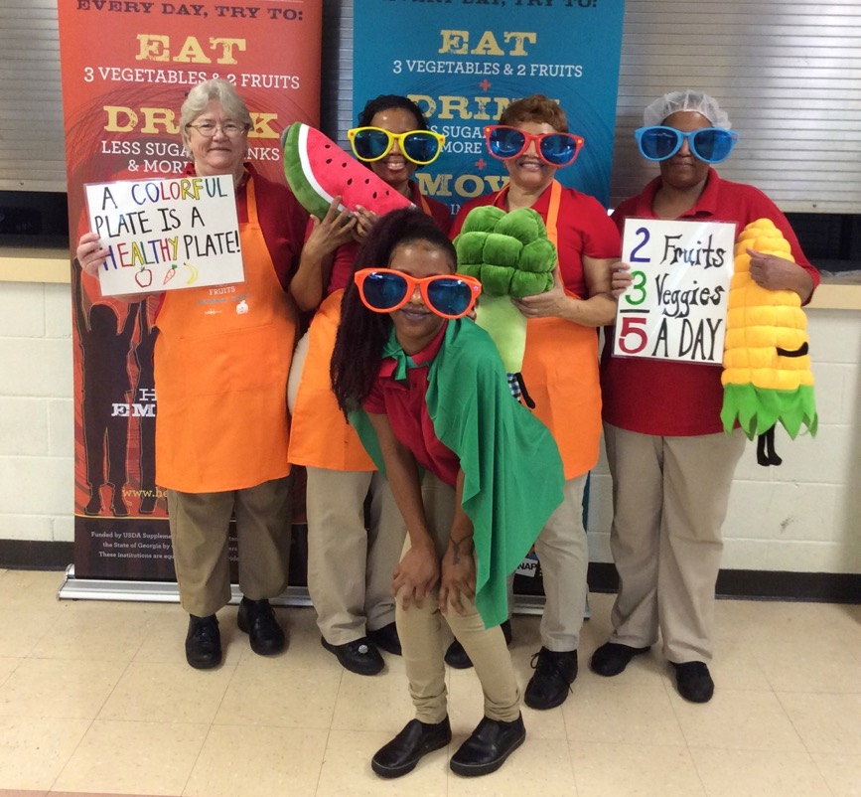
On Our Agenda . . .
Assess your school’s current level of youth engagement
Explore examples of youth engagement
Complete “Don’t Say No” challenge
Notes:
AGENDA
STATE: During this module, we’ll cover essential components of youth engagement and effective ways to engage youth in school health. Today, we will:
assess where your school currently stands on youth engagement
explore real-life examples of youth engagement
take a “Don’t Say No” challenge

Slide 3
Objectives
Define youth engagement and state its benefits
Identify your school’s current level of youth engagement and authenticity
Share real-life examples of youth engagement
Distinguish next steps for improving youth engagement
Notes:
OBJECTIVES
STATE: By the end of this module, you will be able to:
Define youth engagement and state its benefits
Identify your school’s current level of youth engagement and authenticity
Share real-life examples of youth engagement
Distinguish next steps for improving youth engagement

Slide 4
Materials
Handout Packet
#1: Youth Engagement Survey
#2: Levels of Youth Engagement
#3: “Don’t Say No!’’ Challenge
#4: Engaging Youth — Next Steps
#5: Additional Resources
Notes:
MATERIALS
STATE: Let’s review the handouts you were given in the packet. You have several handouts:
#1: Youth Engagement Survey
#2: Levels of Youth Engagement
#3: “Don’t Say No!” Challenge
#4: Engaging Youth — Next Steps
#5: Additional Resources
We will use these throughout the training.

Slide 5
Youth as Partners and Change Agents
Notes:
Whole School, Whole Community, Whole Child Model
STATE: The Whole School, Whole Community, Whole Child (WSCC) model is a unified approach to learning and health with the child or adolescent at the center. It recognizes the need for school-wide engagement as well as community support and demonstrates the interconnectedness of the education and well-being of the child.
The model also puts youth at the center, and this focus establishes that youth should be recognized as full partners in this work. When given safe space and support, youth can be engaged and can be agents of change rather than simply being the targets of programs and rules.

Slide 6
Youth Engagement Is . . .
“The process through which young people engage in and influence the issues and institutions that impact their lives.’’
“When adults ask kids what they think or what they need and when we get to help decide stuff.’’
“When power and credibility are given to students in making decisions and acting on needs without age discrimination.’’
Notes:
What is Youth Engagement?
STATE: What is youth engagement? There are a few different definitions available. Take a minute to read these three definitions.
DO: Allow a minute to read the slide.
STATE: The first definition is from a researcher, the second from a second-grader, and the third from a high-schooler.
ASK: What similarities do you see between these quotes?
NOTE: Allow a few participants to share.
STATE: Regardless of the various definitions, the central theme is: who has the power.

Slide 7
Why is Youth Engagement Important?
For Youth
Allows youth to serve as experts
Builds skills, confidence and connectedness
For Adults
Helps them gain new perspectives and energy
For Schools
Enables them to become more effective in serving youth
For Communities
Sends message of the value of youth
Notes:
Why Is Youth Engagement Important?
STATE: So why is youth engagement important? First and foremost, youth are experts of their own experiences. They can help provide perspectives that adults may be missing.
STATE: When youth are intentionally invited to participate and are invested in their school and their own health and education, they are able to gain real-world skills, confidence, and hands-on knowledge and to feel a spirit of connectedness.
School staff learn from youth, build their skills and capacity to better serve youth, and usually gain a renewed energy in purpose.
Schools and organizations become more effective in serving youth.
Communities also send a strong message to their younger generations about their value in the community. Communities are also better able to coordinate youth services and embrace diversity, including youth.
Are there any other benefits that you can think of for engaging youth?
DO: Facilitate a brief sharing of ideas.
Youth Engagement Survey
STATE: Using Handout #1: Youth Engagement Survey, assess where your school stands on engaging youth in decision-making and programs. Let’s take 3 minutes to assess. Be ready to share with the group.
DO: Give participants 2 minutes to consider their responses. Bring the group back together and ask a few of the following questions.
Do you feel your score reflects the amount of youth engagement going on in your school/organization? Why or why not?
Did you have any trouble answering any of the questions? If yes, which ones and why?
For any of the statements to which you responded yes, provide an example of how the particular engagement is happening.
Did the survey provide you with any new ideas for youth engagement? If so, what?
NOTE: After asking a question, pause to allow participants time to formulate their verbal answers and volunteer to share.

Slide 8
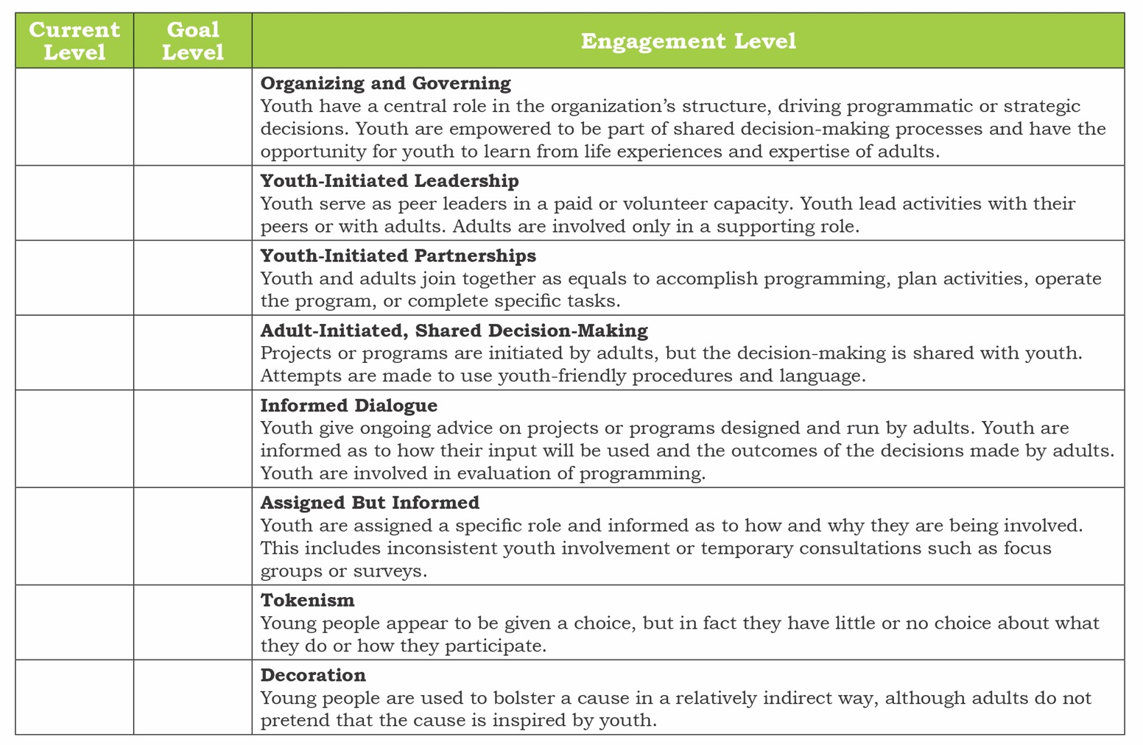
  ✓ Check your current level
  * Asterisk your goal
Adapted from works by J. Nowicki and R. Hart.
Notes:
Authenticity Levels of Youth Engagement
STATE: The degrees of youth engagement range from youth being used as “decoration” to youth “organizing and governing.” In the survey you just took, you looked at whether or not youth are engaged in school health. Now we want to look at the level of engagement.
Take a moment to think again about your survey responses and review Handout #2: Levels of Youth Engagement and determine (1) At what level of youth engagement does your school or organization currently operate for various programs and/or policies.
(2) Which level will you strive to achieve if your goal is to engage youth?
Put a √ by your school’s current level of youth engagement. Then, * your goal or where you would like your school to be with youth engagement.
DO: Allow participants to assess current levels of youth engagement.

Slide 9
Processing
Why did you select the level? What specific examples of youth engagement can you share that support your level?
What level do you aspire to? What steps would you take to get there?
Notes:
PROCESSING
STATE: Okay, let’s divide into groups based on your current school’s level and discuss the following:
Why did you select your level? What specific examples of youth engagement can you share that support the level?
What level do you aspire to? What steps would you take to get there?
STATE: Thank you for sharing. Hopefully you heard of some different youth engagement activities that others are using.

Slide 10
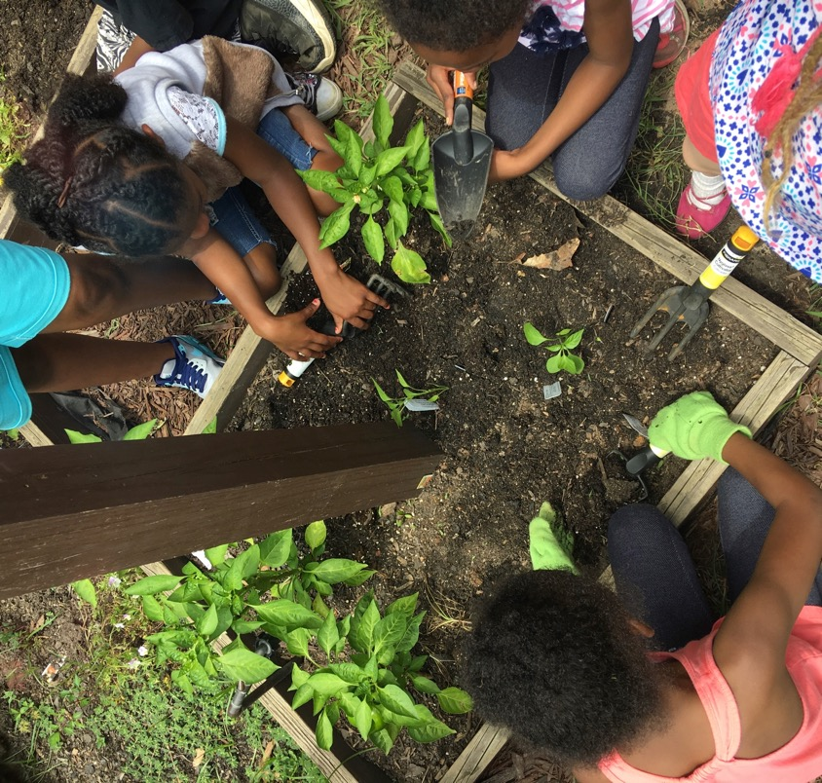
Equity
Equity in Youth Engagement
Fair and just inclusion
Removing barriers
Hearing and including the silenced voice
Notes:
Equity
STATE: As we look at authentic opportunities for engaging youth, we must also consider equity. But what do we mean by equity? Equity means providing people with fair opportunities to attain their full potential. On this slide, you can see two examples of equity—all people have what they need to be successful.
In youth engagement, equity means fair and inclusion. It means removing barriers that limit youth who want to join, participate, and/or lead. It means ensuring that typically silenced youth voices will be heard and included.

Slide 11
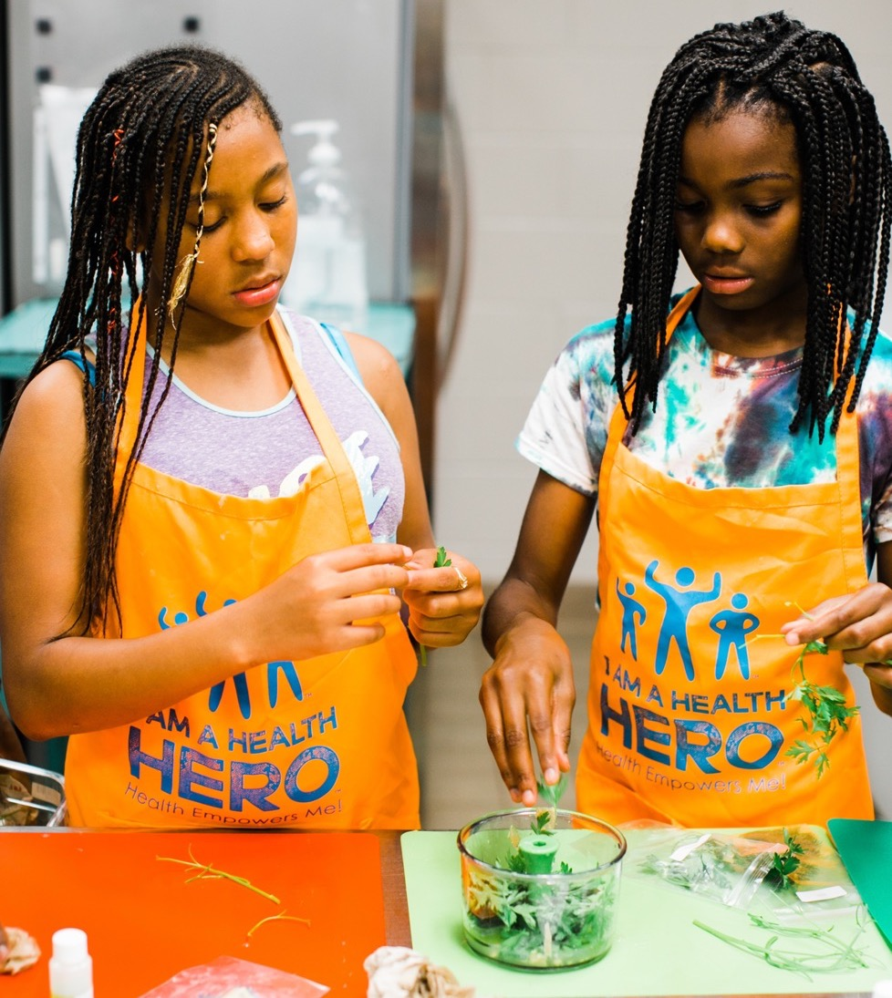
Age-Appropriate Strategies
Youth of ALL Ages can be Engaged
Notes:
What Works: Effectively Engaging Youth in School Health Work
STATE: When thinking about equity, it is important to realize that youth of ALL ages can be engaged in school health work. Kids are brilliant; they are the experts in their lived experiences. So as adults, we need to take time to ask, listen, provide support, help identify resources, and advocate for and with them. In Cherokee County School District in South Carolina, students of all ages are engaged in school health efforts through a project called Fit2gether. Students are empowered to take the lead in building a culture of health in their school and communities. In the next few slides, we will explore how this district has engaged youth from all school levels in school health efforts. In these examples, you will see that the students had a voice in what their school needed or what they perceived as gaps. You will also see that the needs were not the same across the schools.

Slide 12
Engaging K – 5
Blacksburg Primary Change Agents (K‒2) Healthy Cats Market
Limestone Central Elementary and Northwest Elementary advocated for more recess
BD Lee Elementary designed morning exercise program called B.D. Lee KickStart
Notes:
At the elementary level (K–5) . . .
Blacksburg Primary Change Agents (K–2) created the “Healthy Cats” Market, based on their school health mascot to provide healthy snacks and more fruits and veggies outside of the cafeteria. They used the funds for other health/wellness initiatives.
Limestone Central Elementary and Northwest Elementary advocated for more recess to help academics and behavior.
B.D. Lee Elementary designed and advocated for a morning exercise program called B.D. Lee KickStart.

Slide 13
Engaging 6 – 8
Gaffney Middle — recess equipment to encourage more activity
Ewing Middle — school garden
Blacksburg Middle — classroom physical activity
Notes:
At the middle school level . . .
Gaffney Middle chose equipment for students to use at recess to be more active.
Ewing Middle piloted a school garden initiative.
Blacksburg Middle made physical activity in the classroom a priority.

Slide 14
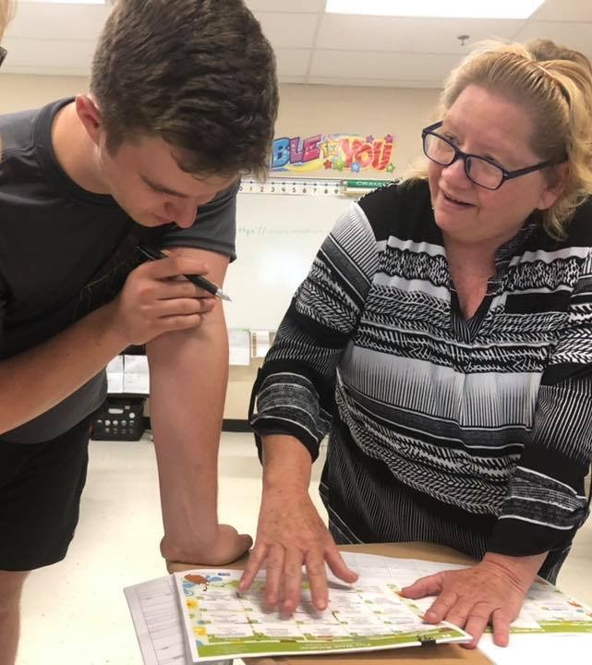
Engaging 9 – 12
Blacksburg High ‒ overhaul of the lunch menu.
Gaffney High and Institute for Innovation ‒ healthy store
Gaffney High Students ‒ FIT2gether
Notes:
At the high school level . . .
The FIT2gether district-wide project was actually the brainchild of Gaffney High anatomy students in response to a discussion about racial and economic disparities in local childhood obesity data in 2013.
Gaffney High and Institute for Innovation students will have a healthy store available to students and staff.
Blacksburg High students partnered with Food Services to overhaul the lunch menu.

Slide 15
What Works: Strategies for Success
Inclusion — engage the disengaged
Validation — safe space, youth-led meeting/gatherings, titles
Participation — real school work (School Health Index)
Training — both students and adults
Connecting — to learning and civic engagement
Recognition — celebrate and promote their work
Notes:
STATE: So how was the work in the Cherokee County School District so successful? They employed a number of strategies.
#1 Inclusion – Ensuring the voice or perspective of all groups of students is heard. This means engaging the disengaged. Each school has students who are not invited to be in clubs, may not perform well academically, have chronic discipline or attendance issues, and/or just don’t like school. These are often the students whose voices we do not hear and whose voices are important. Students bring many different experiences and barriers to health and learning. That is why it is important to make space for all perspectives.
#2 Validation – Another important strategy is making the experiences safe—assuring students know that their feelings and ideas are valid and needed. Giving students official titles, letting them determine how meetings or gatherings are run, giving students credit for their contributions, and showing them how their contributions benefit the school are all examples of validation.
#3 Participation – Engaging students in real work and decision-making is important, but it is also important to make the work fun and challenging. In Cherokee County, students participate in the School Health Index assessment, a comprehensive assessment of school health policy and practices. This leads to a more relevant and accurate representation of the school since students are the greatest stakeholders. Scaffolding reading levels, or partnering youth with adults on an assessment like the School Health Index may be necessary if working with younger students. Students are also members of the school health team or committee.
#4 Training – Students and adults often need guidance on how to work together. Students need guidance on how to work with adults whom they typically see as authority or power figures. Adults need guidance on facilitating not leading. Establishing a clear set of guidelines and expectations for working together is important to do from the beginning.
Creating a safe space for youth to share is critical for accurate and honest representation and contributions. This is vital in building trust between youth and adults. It is also vital for adults to really listen and support youth ideas.
#5 Connecting – Connecting the school health work to classroom learning is also an effective strategy.
#6 Recognition – Celebrate and recognize students’ contributions and achievements. Promote their work to the community to build awareness of youth power, potential, and credibility.
These are elements of success that you need to consider when engaging youth.

Slide 16

Activity
“Don’t Say No!” Challenge
Notes:
“DON’T SAY NO!” CHALLENGE ACTIVITY:
STATE: When working with youth, the quickest way to break trust is to shut down their ideas. Turn to Handout #3 – “Don’t Say No!” Challenge. These are real ideas presented by students in response to data from their school needs assessments. For this activity, read each scenario. The challenge is to formulate a response to the student’s idea without telling the student “no.” Take 5 minutes to complete the handout in guiding students to scale their ideas without losing the focus of their ideas. After 5 minutes, we will share.
DO: Give participants 5 minutes to complete the handout.
STATE: Let’s see what you came up with.
DO: Have a volunteer read the scenario and tell how they would respond. Continue through all three scenarios, if time allows.

Slide 17
Review and Next Steps
Youth engagement and its importance
Levels of youth engagement and authenticity
Age accommodating real-life examples
Strategies for success
Notes:
STATE: We covered several components you can incorporate into effectively engaging youth:
What youth engagement is and why it is important
Levels of youth engagement and authenticity
Real-life examples
Strategies for success
Next steps
STATE: Turn to Handout #4: Engaging Youth – Next Steps and answer the three questions. Be prepared to share your ideas in 3 minutes.

Slide 18
Thank You!
Trainer Contact Info HERE
Notes:
STATE: Thank you for sharing! I know your most important stakeholders — your students — can transform policy and practice and be active participants in their education and communities!
Be sure to check out Handout #5 with some additional resources you may find helpful as you continue your youth engagement work.
My contact information is listed on this last slide should you have any questions.
Please complete the training evaluation.
Thank you!

Slide 19
References
ACT for Youth Center for Community Action. (2019). What is youth engagement, really? Retrieved from http://actforyouth.net/youth_
development/engagement/
Centers for Disease Control and Prevention (CDC). (2018, March 12). Virtual healthy school resource list by WSCC components. Retrieved from https://www.cdc.gov/healthyschools/vhs/resources.html
Checkoway, B. (2011). What is youth participation? Children and Youth Services Review, 33, 340–345. doi: 10.1016/j.childyouth.2010.09.017
Fletcher, A. (2005). Meaningful student involvement: Guide to students as partners in school change [PDF]. Retrieved from https://www.academia.edu/3653493/Meaningful_Student_Involvement_Guide_to_Students_as_Partners_in_School_Change
Hummel, K. (2016, March 7). 5 ways to overcome barriers to youth engagement. National Coalition for Dialogue & Deliberation. Retrieved from http://ncdd.org/rc/item/10802/
National Association of Chronic Disease Directors. (2017). The whole school, whole community, whole child model: A guide to implementation [PDF]. Retrieved from http://www.ashaweb.org/wp-content/uploads/2017/10/NACDD_WSCC_Guide_Final.pdf
Robert Wood Johnson Foundation. (2017, May 1). What is health equity? Retrieved from https://www.rwjf.org/en/library/research/2017/05/
what-is-health-equity-.html
Notes:
References for this training module include the followingACT for Youth Center for Community Action. (2019). What is youth engagement, really? Retrieved from http://actforyouth.net/youth_development/engagement/
Checkoway, B. (2011). What is youth participation? Children and Youth Services Review, 33, 340–345. doi: 10.1016/j.childyouth.2010.09.017
Robert Wood Johnson Foundation. (2017, May 1). What is health equity? Retrieved from https://www.rwjf.org/en/library/research/2017/05/what-is-health-equity-.html
Hummel, K. (2016, March 7). 5 ways to overcome barriers to youth engagement. National Coalition for Dialogue & Deliberation. Retrieved from http://ncdd.org/rc/item/10802/
CDC. (2018, March 12). Virtual healthy school resource list by WSCC components. Retrieved from https://www.cdc.gov/healthyschools/vhs/resources.html
Fletcher, A. (2005). Meaningful student involvement: Guide to students as partners in school change [PDF]. Retrieved from
https://www.academia.edu/3653493/Meaningful_Student_Involvement_Guide_to_Students_as_Partners_in_School_Change
National Association of Chronic Disease Directors. (2017). The whole school, whole community, whole child model: A guide to implementation [PDF]. Retrieved from http://www.ashaweb.org/wpcontent/uploads/2017/10/NACDD_WSCC_Guide_Final.pdf
.

Slide 20
Disclaimer
This project was supported by Cooperative Agreement Number NU38OT000315, funded by the National Center for Chronic Disease Prevention and Health Promotion, Division of Population Health, School Health Branch, from the Centers for Disease Control and Prevention. Contents are solely the responsibility of the authors and do not necessarily represent the official views of the Centers for Disease Control and Prevention or the Department of Health and Human Services.
Notes:
Read disclaimer
Acknowledge the many and varied organizations including school teachers and administrators that helped with the development of the concept and training modules.

